Slide 1
Let’s start coding ☺
Exercises 1 :
modify printing Hello python function code with a comment of the function usage .
def hello python
print(Hello ‘ python!)
___________
Exercises 2 :
Write code to print the expected output using sep and end parameters:
I'm__learning Python
thanks NP :)

Slide 2
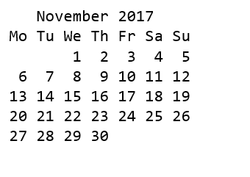
Let’s start coding ☺
Exercises 3 :
in Statistics, the Mean value is calculated by dividing the sum of all values by the count of these values. calculate the mean of 5 numbers 11, 7, 4, 18, 37
Exercises 4:
Write a Python program to print the calendar of a given month and year
year = 2022
month = 4

Slide 3
Let’s start coding ☺
Exercises 5 :
Write a Python program that accepts an integer (n) and computes the value of n+nn+nnn.
Exercises 6 :
Write a Python program that accepts a word from the user and reverse it
example
enter a word: Abcd
Reversed : dcbA

Slide 4
Let’s start coding ☺
Exercises 7 :
Write script to dynamically remove empty strings and numbers from the list
list1 = [9,"I’m", "", " learning ", " python ", "", " at NP"]
Exercises 8 :
Counts the number of occurrences of item 50 from a tuple
tuple1 = (50, 10, 60, 70, 50)

Slide 5
Let’s start coding ☺
Exercises 9:
Return a new sorted set of identical items from a given two set
set1 = {10, 20, 30, 40, 50}
set2 = {30, 40, 50, 60, 70}
Exercises 10 :
Convert two lists into a dictionary
keys = ['Ten', 'Twenty', 'Thirty']
values = [10, 20, 30]

